Slide 1

Department of BES-II
Basic Electrical and Electronic Circuits 23EC1203
Topic:
CLIPPERS AND CLAMPERS
Session – No.

Slide 2



AIM OF THE SESSION
The aim of a session on clippers and clampers typically involves understanding and working with electronic circuits that are used to shape or modify waveforms in electronic systems
INSTRUCTIONAL OBJECTIVES
This Session is designed to:
The primary objective of studying clippers is to learn how to selectively clip or limit certain portions of a waveform.
The primary objective of studying clampers is to understand how to shift the DC level or bias of a waveform
LEARNING OUTCOMES
At the end of this session, you should be able to:
Student will be capable of analyzing the impact of clipping on the shape and characteristics of a waveform.
Student will acquire a deep understanding of how clampers shift the DC level or bias of a waveform.

Slide 3
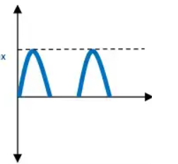
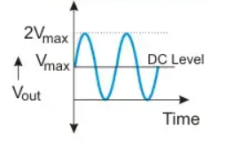

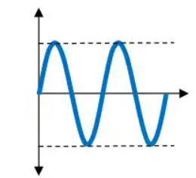
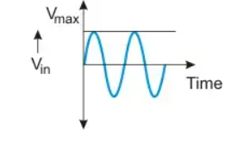
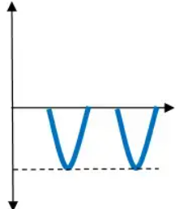
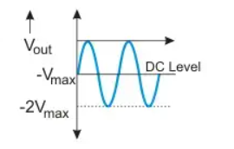
SESSION INTRODUCTION
O/P waveform 1
O/P waveform 1
Input waveform
Input waveform
O/P waveform 2
O/P waveform 2

Slide 4
Wave Shaping Circuits
Wave shaping circuit : It is a process of changing the shape of a waveform
Wave Shaping Circuits
Linear Wave Shaping
Non-Linear Wave Shaping
Clipper
Clamper
Non-linear wave shaping circuits utilize diodes alongside resistors to modify waveforms, achieving either waveform attenuation or DC level alteration for desired output.

Slide 5
Clippers
A Nonlinear wave shaping circuit which can cut or trim the unwanted portion of the waveform.
A clipper circuit prevents the output waveform from exceeding a certain level and at the same time it does not distort the remaining part of the waveform.
Clipper circuit
Input waveform
O/P waveform 1
O/P waveform 2

Slide 6
Types of Clipper Circuits
Clipper Circuits
Series Clipper circuits
Shunt Clipper circuits
Positive
Negative
Positive biased
Negative biased
Positive
Negative
Positive biased
Negative biased
In a series clipper, the diode is connected in series with the load resistor and input signal source.
In a shunt clipper, the diode is connected in parallel (shunt) with the load resistor and input signal source.
NOTE

Slide 7
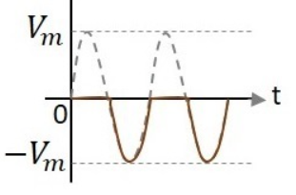
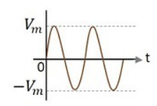
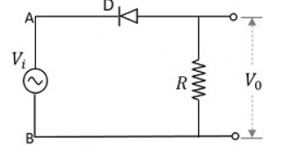
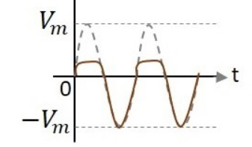
Series Clipper Circuits
Positive Series Clipper Circuit : A Clipper circuit in which the diode is connected in series to the input signal and that attenuates the positive portions of the waveform, is termed as Positive Series Clipper. The following figure represents the circuit diagram for positive series clipper.
Ideal output
Input waveform
Positive series clipper Ckt
Practical output

Slide 8
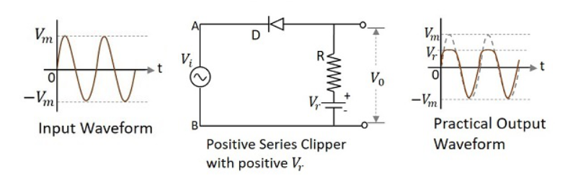
Positive Series Clipper with Positive Biased (Vr)

Slide 9
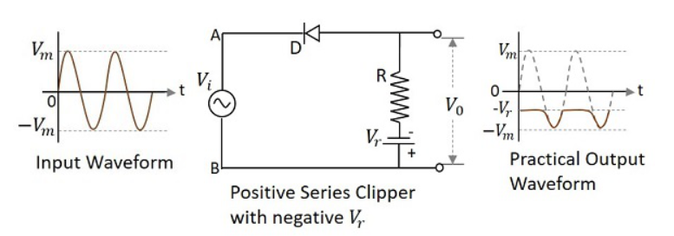
Positive Series Clipper with Negative Biased (Vr)

Slide 10
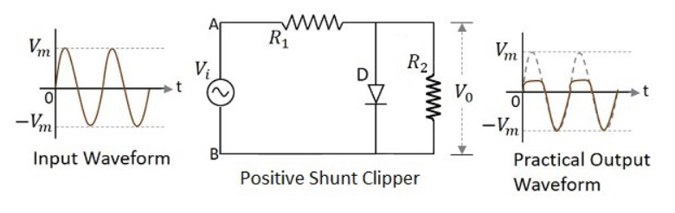
Positive Shunt Clipper

Slide 11
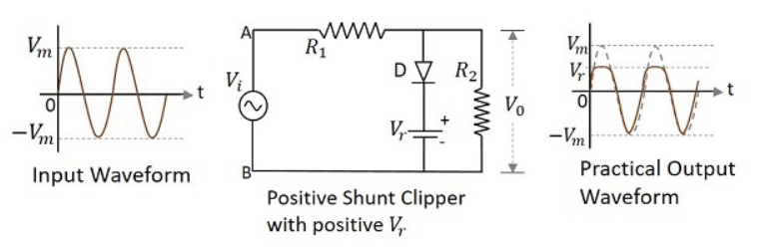
Positive Shunt Clipper with Positive Biased (Vr)

Slide 12
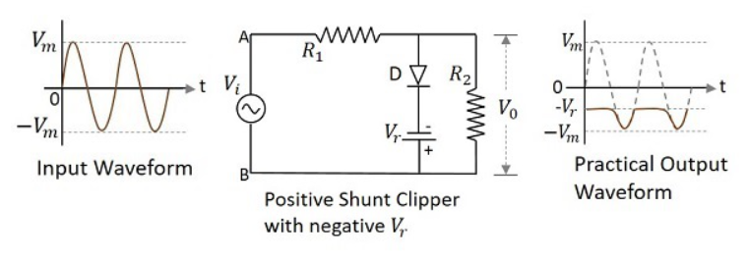
Positive Shunt Clipper with Negative Biased (Vr)

Slide 13
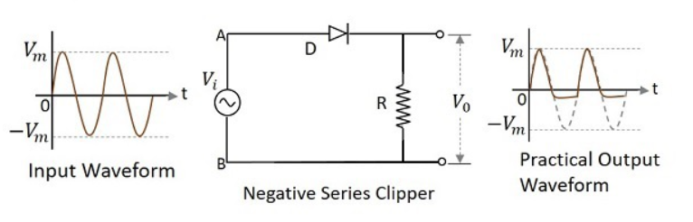
Negative clippers

Slide 14
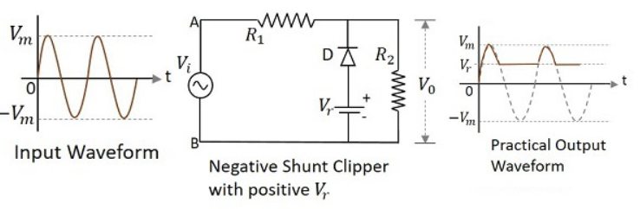
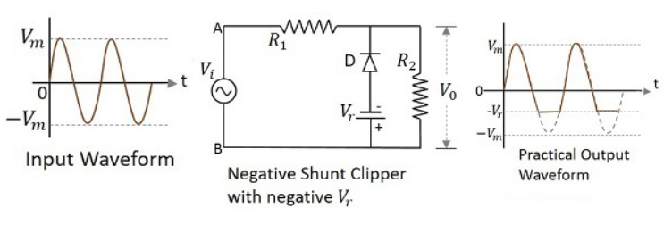
Negative Shunt Clipper with Positive biased( Vr) and Negative Biased (Vr)

Slide 15
Clampers
A Clamper Circuit is a circuit that adds a DC level to an AC signal. Actually, the positive and negative peaks of the signals can be placed at desired levels using the clamping circuits.
Clamper circuits consist of energy storage elements like capacitors. A simple clamper circuit comprises of a capacitor, a diode, a resistor and a dc battery if required.

Slide 16
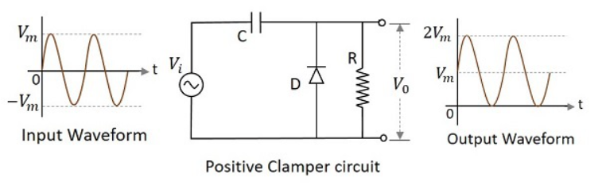
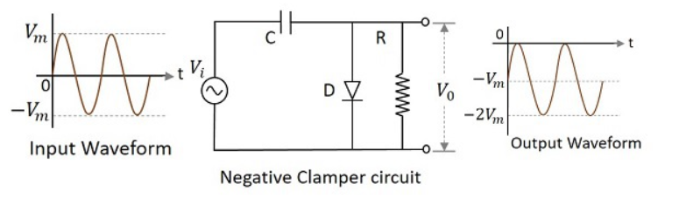
Positive Clamper and Negative clamper circuit

Slide 17
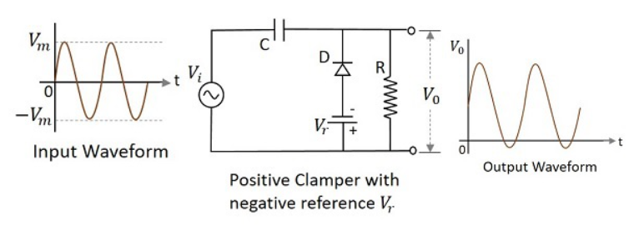
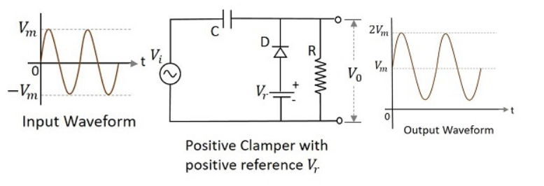
Positive Clamper with Positive biased and Negative( Vr )

Slide 18
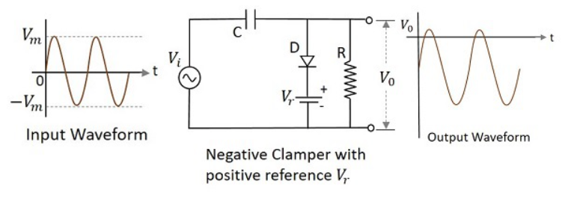
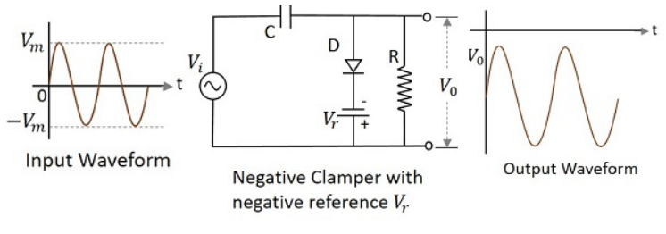
Negative Clamper with Positive biased and Negative( Vr )

Slide 19
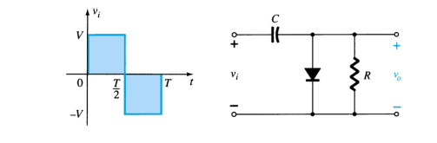
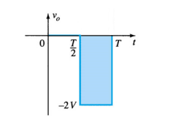
Solved Examples on Clamper Circuit
1. Consider the clamping circuit below and plot the output waveform. Assume the diode is ideal.
solution

Slide 20
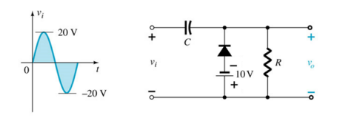
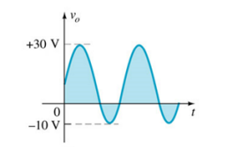
Example 2 : Consider the clamping circuit below and plot the output waveform. Assume the diode is ideal
Solution

Slide 21

SUMMARY
In summary, clippers are used to limit the amplitude of a signal by removing certain voltage levels, while clampers shift the DC level of a waveform without altering its shape. Both circuits play crucial roles in signal processing and electronic system design.

Slide 22
SELF-ASSESSMENT QUESTIONS
What is the primary function of a clipper circuit?
Frequency Modulation
Amplitude modulation
Phase shifting
Pulse width modulation
Which type of clipper removes the positive portion of a signal above a specified voltage level?
Positive clipper
Negative clipper
Biased clipper
None of the above

Slide 23
SELF-ASSESSMENT QUESTIONS
3. In a biased clipper circuit, the biasing voltage is applied to:
The input signal
The diode
Capacitor
Load resistor
What is the primary purpose of a clamper circuit?
Amplitude modulation
DC level shifting
Frequency shifting
None of the above

Slide 24
TERMINAL QUESTIONS
1. Explain the operation of a diode clipper. How does it limit the amplitude of a signal, and what are the differences between a positive and negative diode clipper?
2. Discuss the significance of biasing in a biased clipper circuit. How does the bias voltage affect the clipping operation, and what role does it play in shaping the output waveform?
3. Describe the purpose of a clamper circuit in electronic systems. Provide examples of situations where DC level shifting is crucial, and explain how a clamper accomplishes this.
4. Contrast the operation of a biased clamper with a simple clamper. What additional features does biasing introduce, and how does it affect the output?

Slide 25
REFERENCES FOR FURTHER LEARNING OF THE SESSION
Reference Books:
1.
2.
3.
Sites and Web links:
1.
2.
3.

Slide 26
THANK YOU
Team – Fundamentals of IoT & Sensors

